Slide 1



Salary Prediction using ensemble machine learning
Random Forest • Gradient Boosting • XGBoost • Voting Regressor

Slide 2
Problem statement
Goal: To build a machine-learning model that accurately predicts job salaries based on job title, company attributes, skills, and location.
WHY ?
Helps compare fair compensation
Useful for job seekers and HR
Real-world regression problem

Slide 3
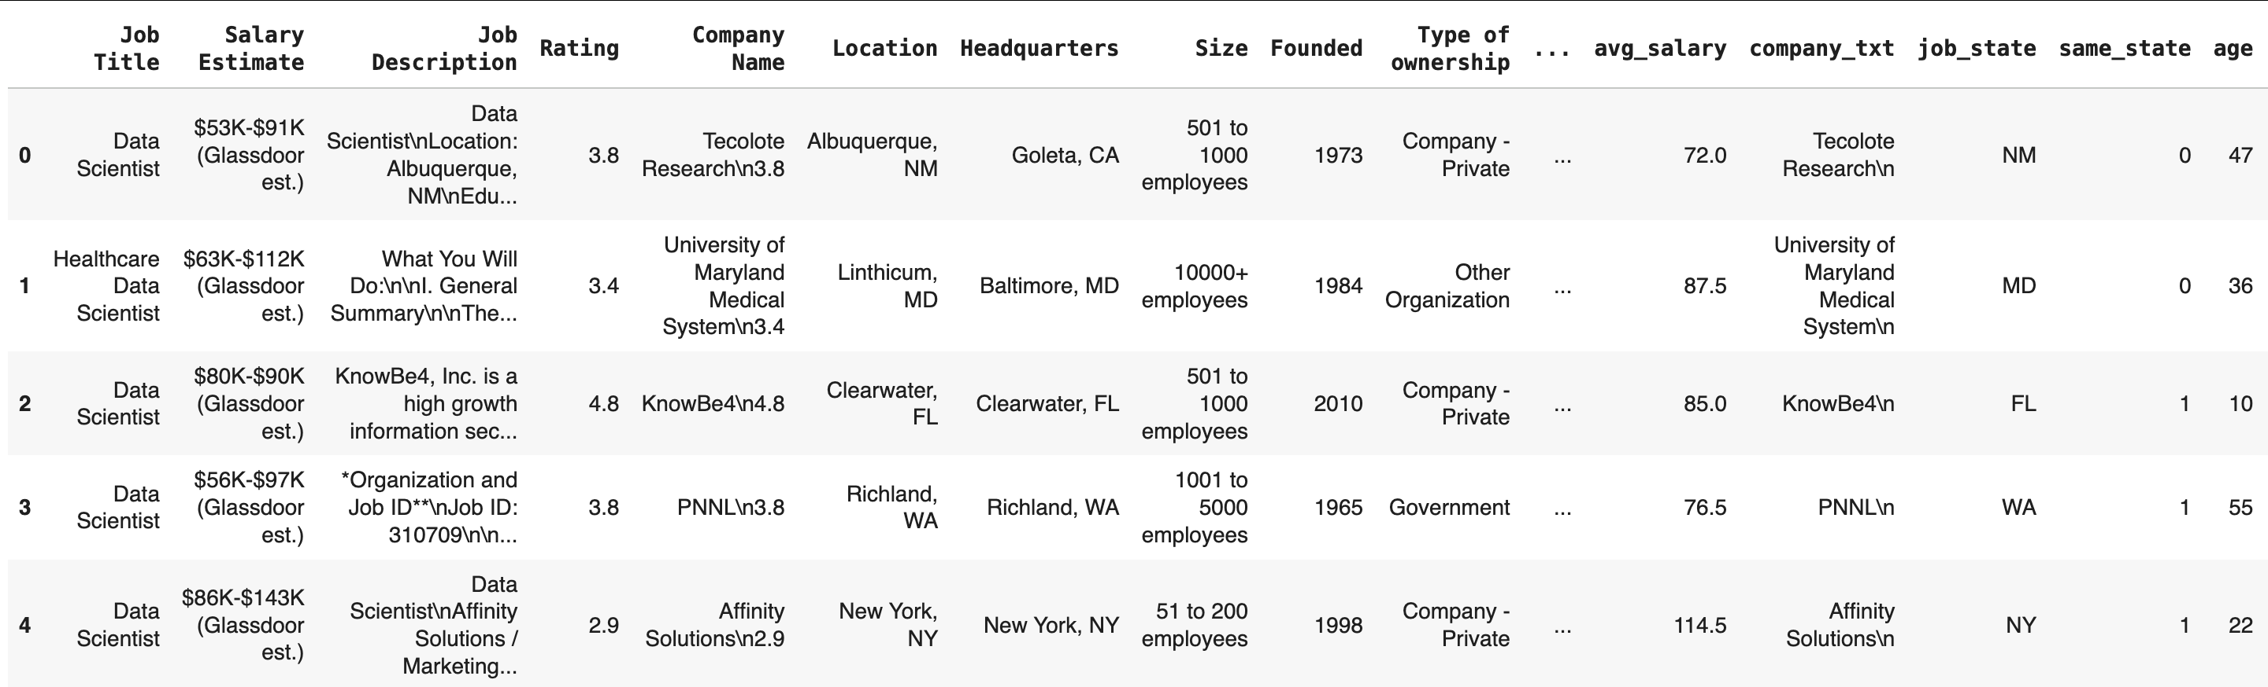
DATASET OVERVIEW

Slide 4
Data preprocessing
Data Cleaning
Feature Engineering
Preprocessing
(encoding + scaling)
ML models
Voting Ensemble
Final Prediction

Slide 5
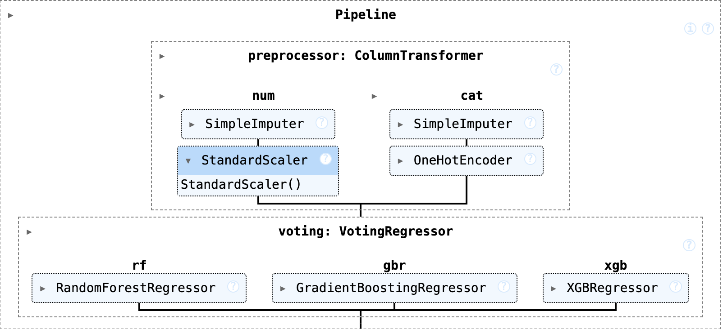
pipeline

Slide 6
Feature engineering
Job Title
Company Type & Size
Location / Job State
Salary ranges
Tech Skills (Python, AWS, Spark, Excel, R)
Company Rating & Age

Slide 7
MACHINE LEARNING MODELS
Voting Regressor
(Ensemble)
Random Forest Regressor
Gradient Boosting Regressor
XGBoost Regressor

Slide 8
Evaluation metrics
Meaning:
Extremely low prediction error
99.9% of salary variation explained
Model performs near-perfectly
RMSE | 1.06325
MAE | 0.49797
R² Score | 0.99930

Slide 9
CHALLENGES
Noisy Salary Data : Salary values in the dataset were messy or inconsistent. Example : Missing salary values, Salary ranges that didn’t match (min > max), Inaccurate or incomplete entries.
Many Categorical Features : The dataset had many non-numerical columns like: Job Title, Location, Company Type, Sector, Industry. Machine learning models can’t understand text directly.
High-Cardinality Columns : Some categorical columns had too many unique values, such as : Company Name, Location, Industry, Sector. A column with many unique values creates: Very large feature matrices, High memory usage, Risk of overfitting, Slower training.

Slide 10
SOLUTIONS
Noisy Salary Data : Cleaned the dataset by standardizing salary fields, removing inconsistent entries, and using avg_salary as the final target value to ensure reliable predictions.
Many Categorical Features : Applied a preprocessing pipeline using OneHotEncoding to convert categorical text fields into numerical form so the ML models could understand them.
High-Cardinality Columns : Used handle_unknown='ignore' in the encoder, selected only relevant categories, and trained ensemble models (RF, XGB) that naturally handle large feature spaces without overfitting.

Slide 11
conlusion
Ensemble ML significantly improves accuracy :By combining multiple strong models, ensemble learning reduces bias and variance, leading to more stable and accurate salary predictions than any single model alone.
Voting Regressor outperformed individual models : The Voting Regressor leveraged the strengths of Random Forest, Gradient Boosting, and XGBoost, producing more reliable predictions and outperforming each model when tested independently.
Predicts salary with 99.93% accuracy : The final ensemble model achieved an outstanding R² score of 0.9993, meaning it can explain almost all salary variation in the dataset with very low prediction error.
Ready for deployment (model saved as .pkl) : The entire preprocessing pipeline and trained ensemble model are exported as a .pkl file, making the system easy to load, reuse, and integrate into real-world applications or APIs.

Slide 12
THANK YOU
Name : md kaif Nawaz Khurram
Github link : https://github.com/WebWizard5243/salaryPrediction

